Slide 1

FUSION CLOCK
A business-first, online, social media alarm application.
By Robert Aries
And Jake Mortlock

Slide 2


Agenda
Overview of the alarm functions
Application in networking
Monetisation

Slide 3
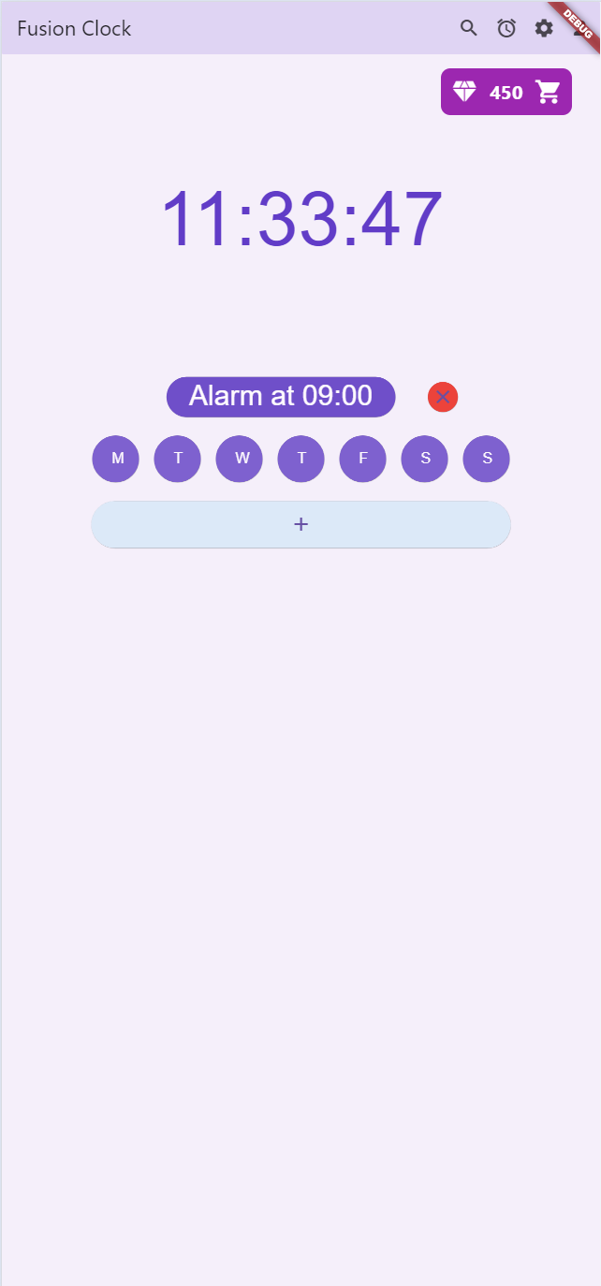
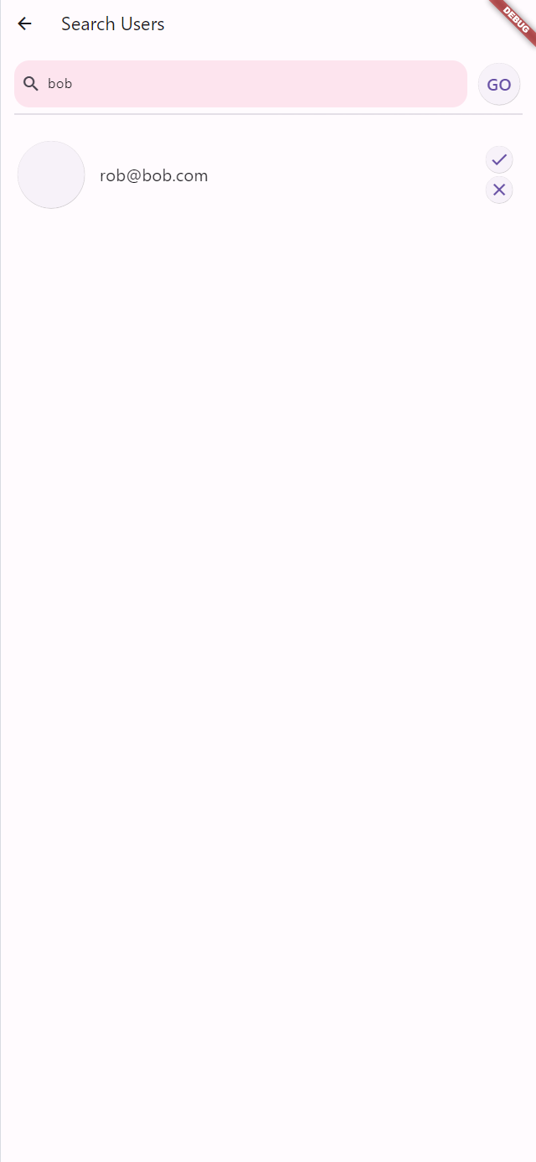
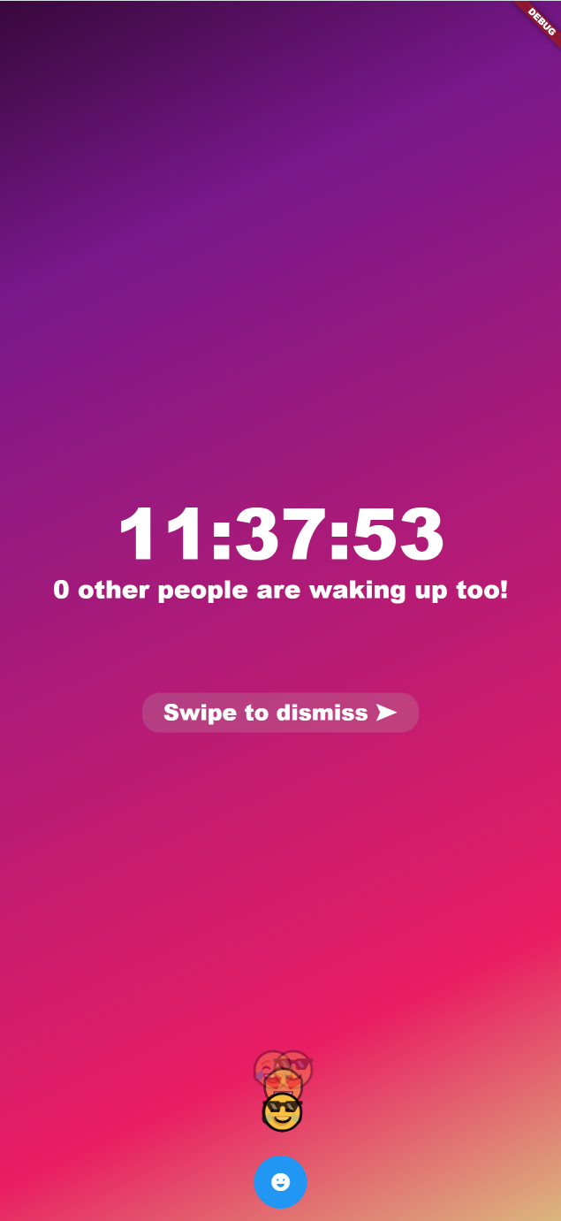
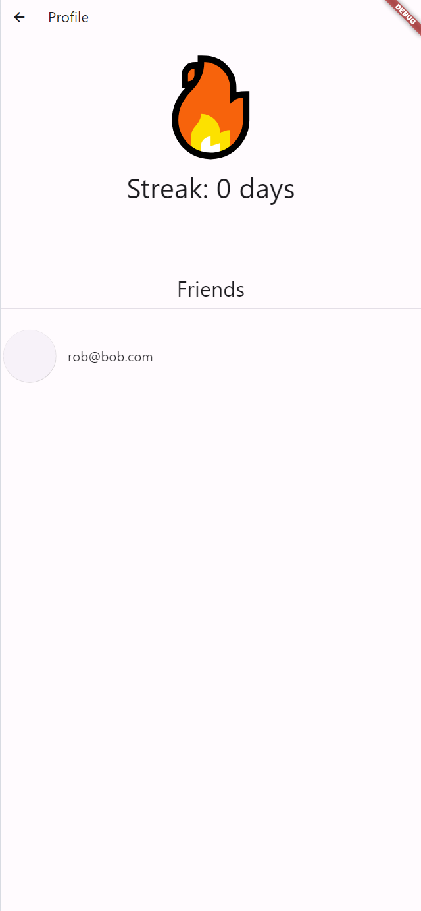
Front End

Slide 4
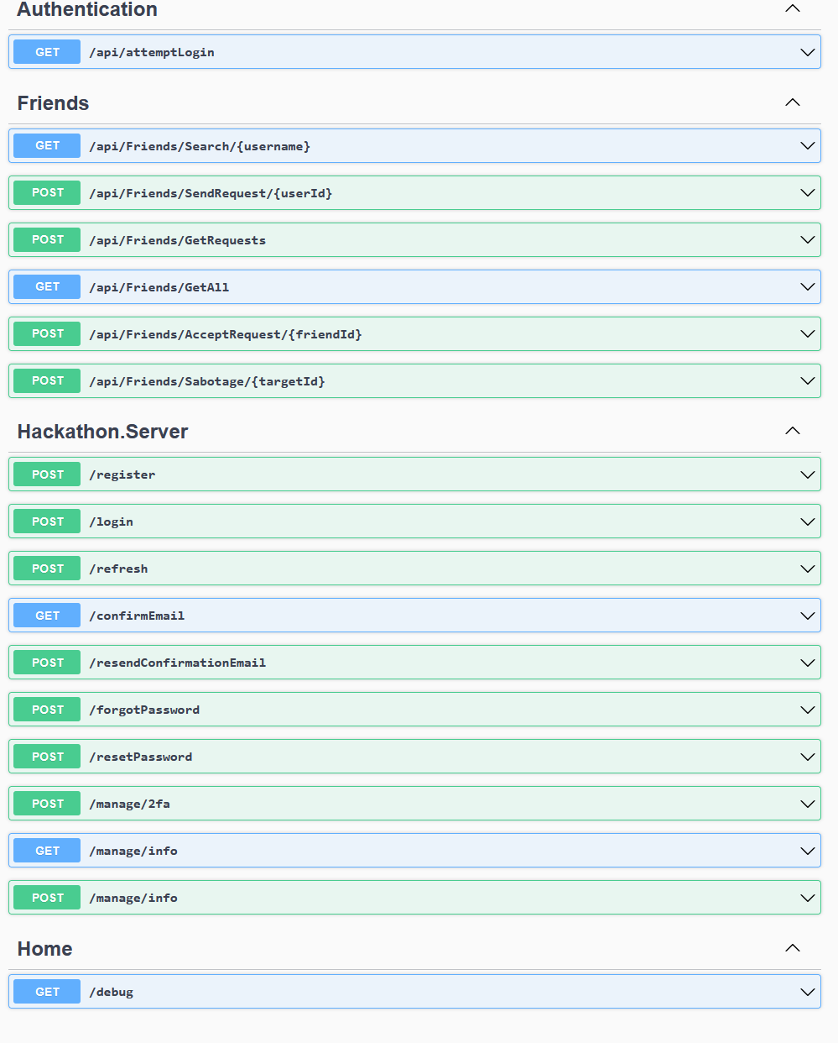
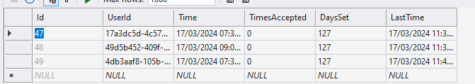
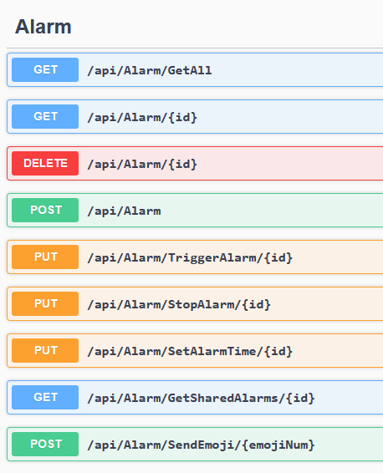
Back End
ASP.Net API with Swagger documentation.
EF Database integration.
Features:
Login, Registration & Authentication
Friend searching & accepting
Cloud-saved alarms
Real-time reaction sharing

Slide 5
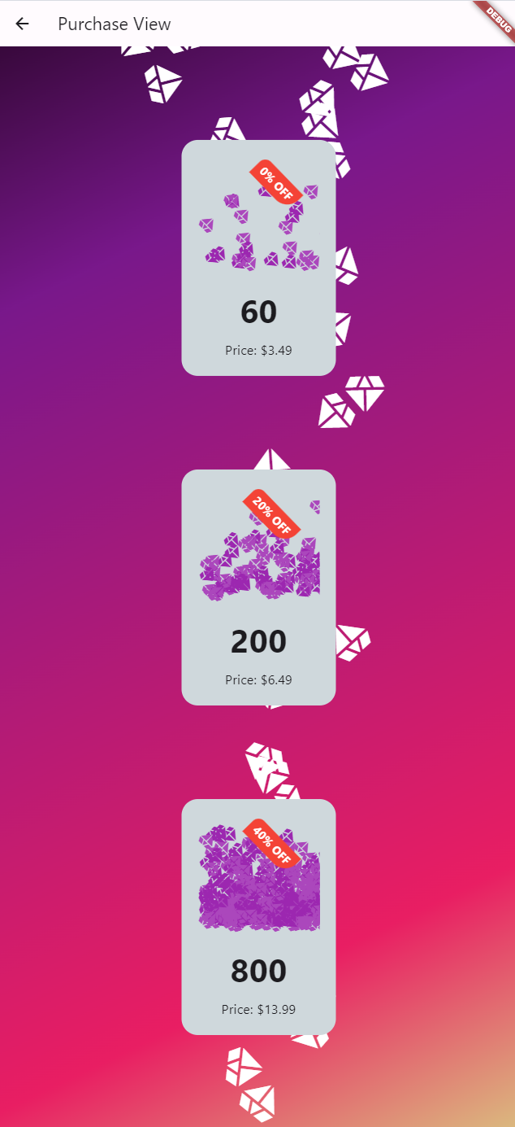
Monetisation strategy
In-app purchases through a gem system.
Sabotage your friends by spending gems to disrupt their alarm!

